Slide 1

Seminar 6
UBIQUITOUS SENSOR NETWORK LABORATORY
Department of Electronics Engineering, Keimyung University
20th May 2016
By Tran Viet Cuong

Slide 2
INDEX
Analysis of EMG signal Progessing
Data acquisition and signal processing
Feature Extraction
Pattern Classification
Wavelet Transform
Reasons that WT is selected
Discrete WT
DWT in EMG signal
Hand-movements Regconition using DWT
Multi-signal DWT
Raspberry and Python
DLSR camera controller project
Reference
UBIQUITOUS SENSOR NETWORK LABORATORY

Slide 3
Analysis of EMG signal Processing
Data acquisition and Signal processing
Feature Extraction
Pattern classification
UBIQUITOUS SENSOR NETWORK LABORATORY

Slide 4
1. Data acquisition and signal Processing
Low amplitude form 0 -> 1.5mV (RMS)
Power spectral density ranges from 10-500 Hz
Low, High and Notch Filter, gain of 200 – 500
The sampling frequency used for the work is 2kHz
UBIQUITOUS SENSOR NETWORK LABORATORY

Slide 5
2. Feature Extraction
Available data is first divided into small segments each of 200ms duration
Time-domain features are advantageous for real-time applications and provide uncomplicated computation
Features are depends on purpose are extracted: MAV, difference the MAV of 2 samples, Zero count, VAR …
Feature extraction methods:
Wavelet Analysis Time Frequency Analysis
Auto Regressive Analysis
Power Spectral Density
Spectral Magnitude Averages
Short time Fourier Transform
Thompson Transform
Frequency Domain Approaches
UBIQUITOUS SENSOR NETWORK LABORATORY

Slide 6
3. Pattern Classification
Fuzzy logic classifier (FLC) is better accuracy in real-time classification
Database defines the membership functions of the fuzzy sets of inputs and outputs
A rule base consists of a number of fuzzy “if-then” rules, which decides the class to which the respective inputs belong
A fuzzification Interface fuzzifies the crisp inputs and converts the degrees of match with linguistic values
A decision making unit performs the implication operations on the rules.
A defuzzification interface defuzzifies the fuzzy outputs that transform
UBIQUITOUS SENSOR NETWORK LABORATORY

Slide 7
Wavelet Transform
Reasons that WT is selected
DWT
DWT in EMG signal
Handmovements Recognition
Multi-signal DWT
UBIQUITOUS SENSOR NETWORK LABORATORY

Slide 8
1. Reasons that WT is selected
Fourier Transform analyze the frequency components of the signal. However if we take the FT over the whole time axis we cannot tell at what instant a particular frequency rises
STFT uses a sliding window to find spectrogram and give both time and Frequency. However, the length of window limits the resolution in frequency
UBIQUITOUS SENSOR NETWORK LABORATORY

Slide 9

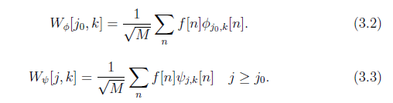
2. Discrete Wavelet Transform
Suppose the scaling function and wavelet functions are given as Haar, Daubechies, ... Then the basis are known, we can approximate a discrete signal:
are discrete functions defined in [0, M-1]
(3.2) are called approximation coefficients
(3.3) are called detailed coefficients.
UBIQUITOUS SENSOR NETWORK LABORATORY

Slide 10
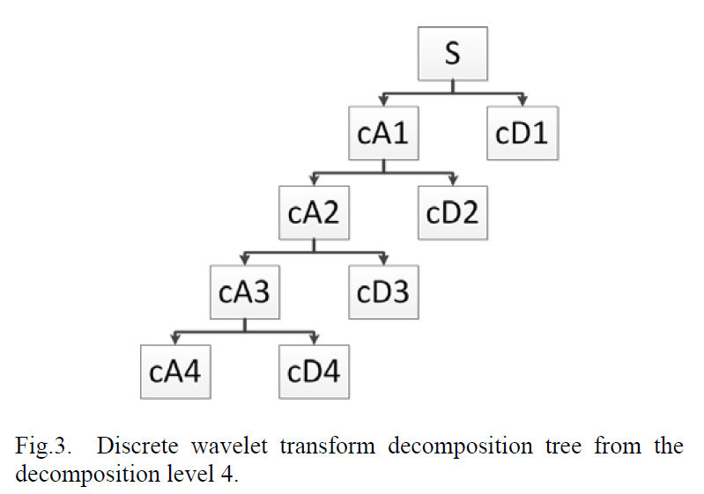
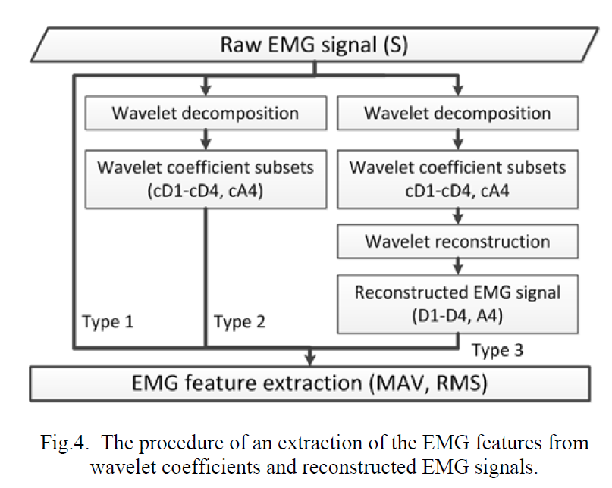
3. Discrete Wavelet Transform for EMG signal
DWT transforms an interested signal into multi-resolution subsets of coefficients that eliminate the unwanted frequency components.
EMG signal, 4th level of wavelet decomposition show better performance than the others.
Reconstruction of a signal is done by using the inverse wavelet transform that is performed by using the coefficients of all the components of the 4th level decomposition (cA4, cD1, cD2, cD3, cD4).
The optimal wavelet function is dependent on the type of interested applications. (Daubechies, Haar ..)
UBIQUITOUS SENSOR NETWORK LABORATORY

Slide 11
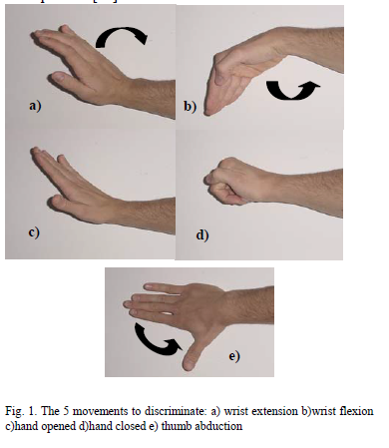
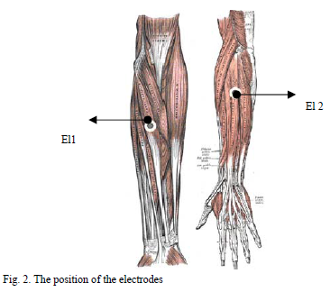
4. Hand movements Recognition using DWT
UBIQUITOUS SENSOR NETWORK LABORATORY

Slide 12
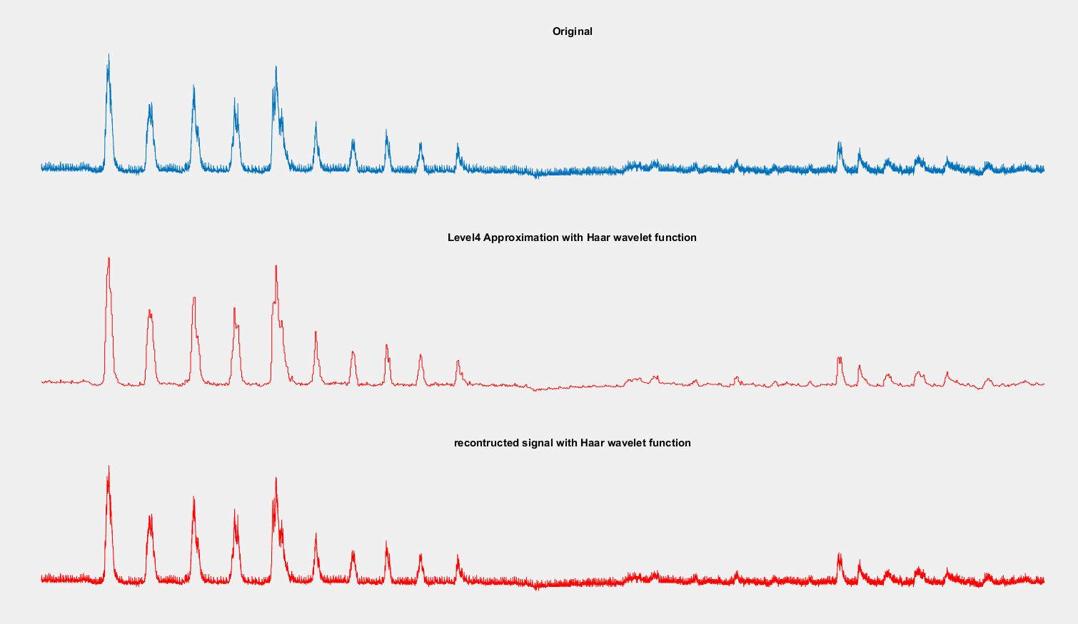
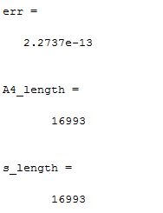
4. Hand movements Recognition using DWT
UBIQUITOUS SENSOR NETWORK LABORATORY

Slide 13
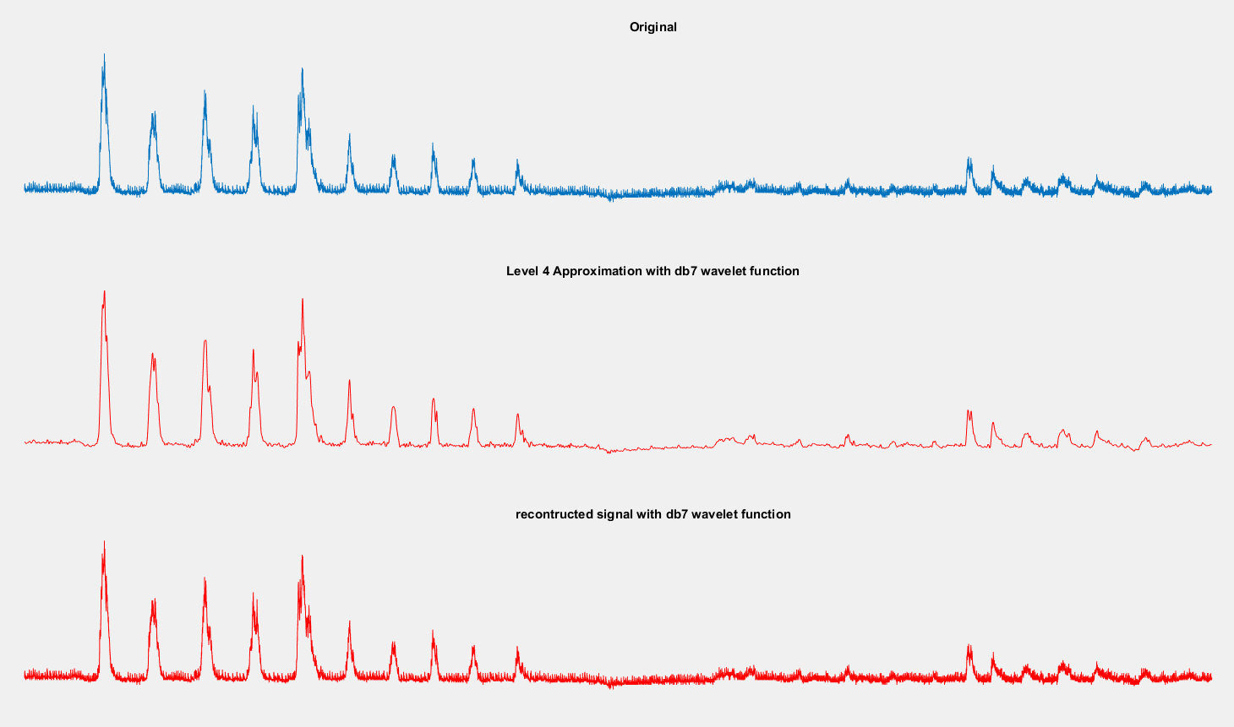
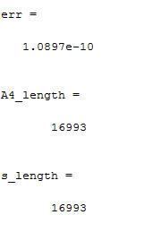
4. Hand movements Recognition using DWT
UBIQUITOUS SENSOR NETWORK LABORATORY

Slide 14
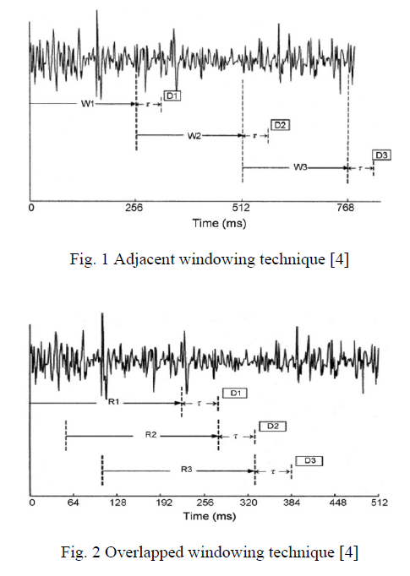
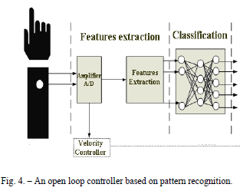
4. Hand movements Recognition using DWT
UBIQUITOUS SENSOR NETWORK LABORATORY

Slide 15
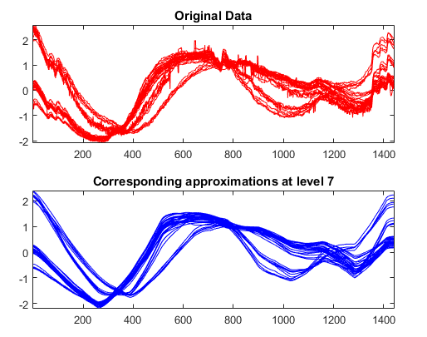
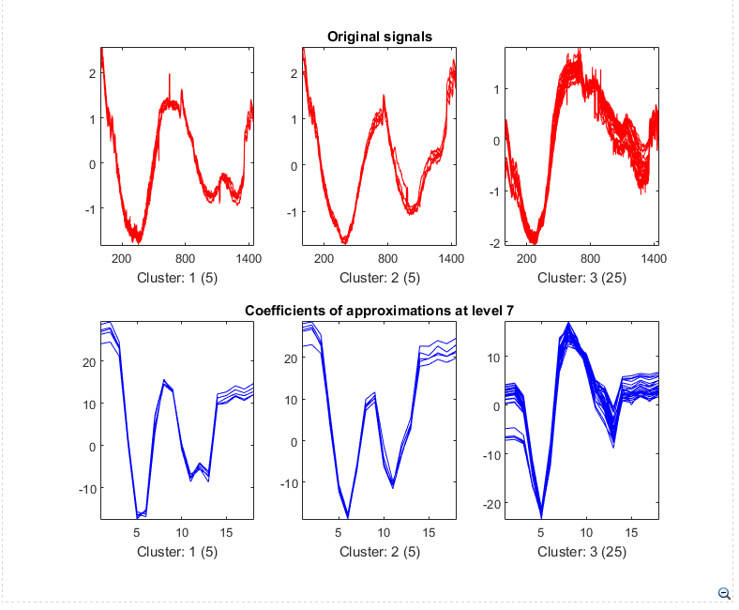
5. Example for Mutil-signal DWT
let consider a real-life multi-signal representing 35 days of an electrical load consumption, centered and standardized.
Summary
Denoising, compression and clustering using wavelets are very efficient tools. The capacity of wavelet representations to concentrate signal energy in few coefficients is the key of efficiency. In addition, clustering offers a convenient procedure to summarize a large set of signals using sparse wavelet representations.
c
UBIQUITOUS SENSOR NETWORK LABORATORY

Slide 16
Raspberry pi and Python
DSLR Camera Controller:
Timelase controller
Film simulation
Wifi transfer function to upload pictures to social web (Flickr)
API Web
internet
Android phone
Raspi pi
DSLR Camera
bluetooth
USB
UBIQUITOUS SENSOR NETWORK LABORATORY

Slide 17
in next 2 weeks
Handmovements Recognition using EMG signal on Rasp Pi ( real-time)
GRS signal
Keep doing DSLR camera cotroller
UBIQUITOUS SENSOR NETWORK LABORATORY

Slide 18
Reference
[1] Fuzzy Logic and Probabilistic Neural Network for EMG Classification – A Comparitive Study (Shalu George K, K S Sivanandan, K P Mohandas)
[2] Application of Wavelet Analysis in EMG Feature Extraction for Pattern Classification (A. Phinyomark, C. Limsakul, P. Phukpattaranont)
[3] The Utility of Wavelet Transform in Surface Electromyography Feature Extraction – A Comparative Study of Different Mother Wavelets (F A Mahdavi, S A Ahmad, M H Marhaban, M-R. Akbarzadeh-T)
[4] Wavelet analysis based feature extraction for pattern classification from single channel acquired EMG signal (S Sharma, G Kumar)
[5] EMG Analysis Using Wavelet Functions to Determine Muscle Contraction ( M. B. I. Reaz, M. S. Hussain, F. Mohd-Yasin)
[6] Techniques for Feature Extraction from EMG signal
[7] Wavelet Toolbox 4 (M Misiti, Yves Misiti, Georges Oppenheim, Jean-Michel Poggi)
[8] Classification of EMG signals through wavelet analysis and neural networks for controlling an active hand prosthesis (Matteo Arvetti, Giuseppina Gini, Michele Folgheraiter)
[9] A tutorial of the Wavelet Transform (Chun-Lin, Liu)
UBIQUITOUS SENSOR NETWORK LABORATORY

Slide 19
Any Questions ?
UBIQUITOUS SENSOR NETWORK LABORATORY

Slide 20
THANK YOU!
UBIQUITOUS SENSOR NETWORK LABORATORY

